Slide 1
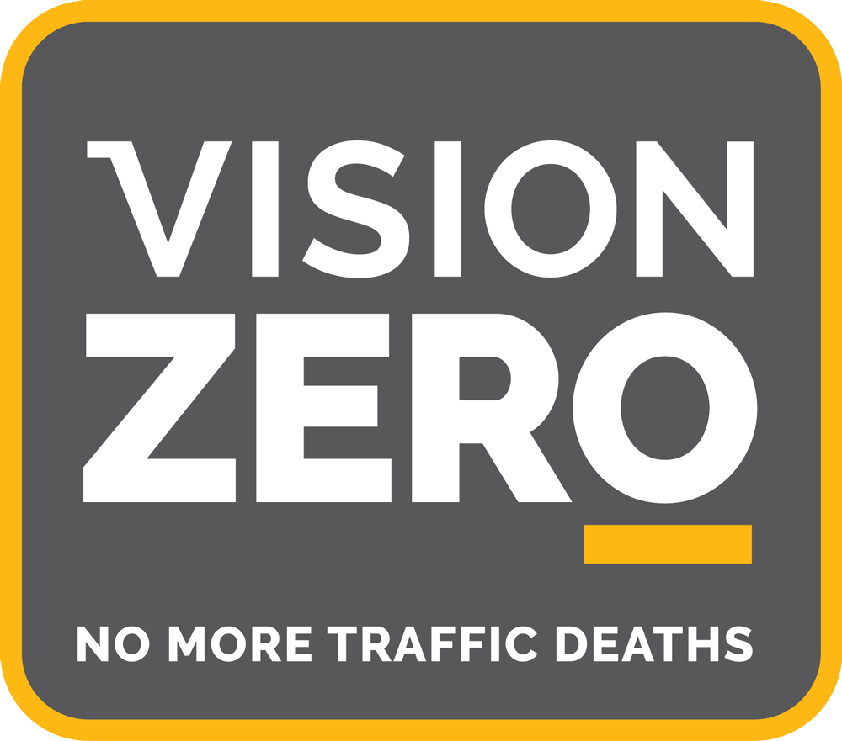
Eliminating Traffic Deaths in Our City of Madison
--Detao Yu, Jing Huang, Boyu Shen

Slide 2
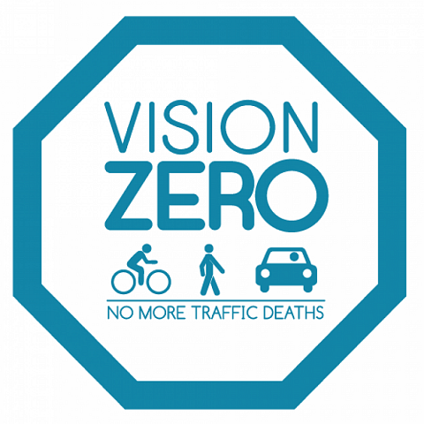
Vision Zero is a multi-national road traffic safety project that aims to achieve a highway system with no fatalities or serious injuries involving road traffic. It started in Sweden and was approved by their parliament in October 1997.
Notes:
Hi everyone, our team is doing the project vision zero, I’m Detao, Jing, Boyu.
Before we start, some may ask what is the vision zero project. So the vision zero project is basically a muti-national project that aims to eliminate all traffic deaths or serious injuries, to make our streets safer.

Slide 3
Some Facts of Crashes in Madison
26% of fatal accidents are the result of overspeed
Top three vehicles that caused most fatalities:Car (70%), Motorcycle (9%),Utility Truck (7%)
The percent of the population aged 20-30 is 25.6% in Madison, but makes up 56.1% of alcohol-related crashes.
51.9% of accident fatalities happened during the night time(20pm-6am) in Madison. Death rate during night time is 3 times as high as day time.
Over 50% of accidents happened on only 6% of streets in Madison, E Washington Ave has the greatest number of crashes

Slide 4
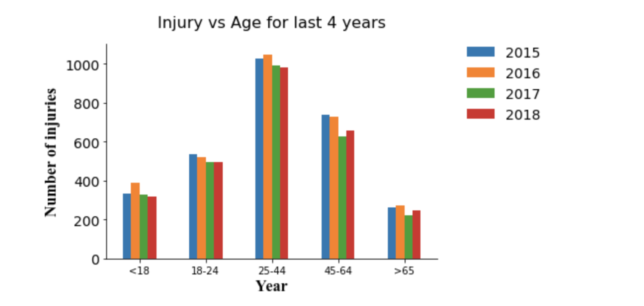
Trend of injury vs age for the last 4 years
People who are 25-44 years old cause the most injuries over the last 4 years
There are still substantial amount of people who are older than 65 years old drive and cause injuries.
There are even more people under 18 years old drive and cause injuries.
Suggestions:
Control the amount of elder people (>65) to drive since their health condition or the amount of time they are able to concentrate their attention on road condition will decrease.

Slide 5
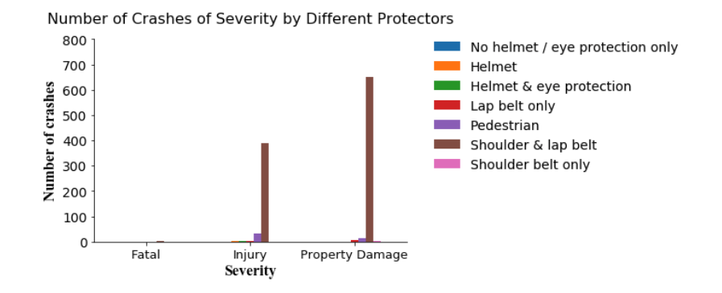
Intersection of John Nolen Drive and Blair Street
Notes:
Among all of the vehicle types, car is a large portion, and cars usually have shoulder and lap belt, so this kind of protector has many crashes. But since car has many large crashes, for the fatal number, the percentage of fatal is very small, which means that the seat belt is very useful. So we ignore the biggest part caused by cars.

Slide 6
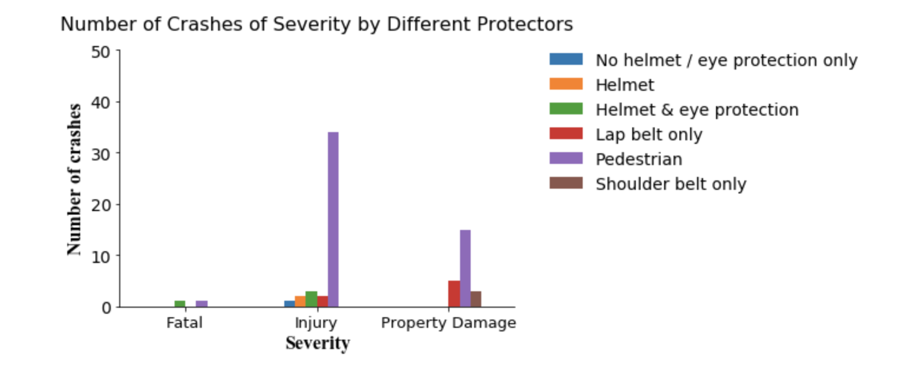
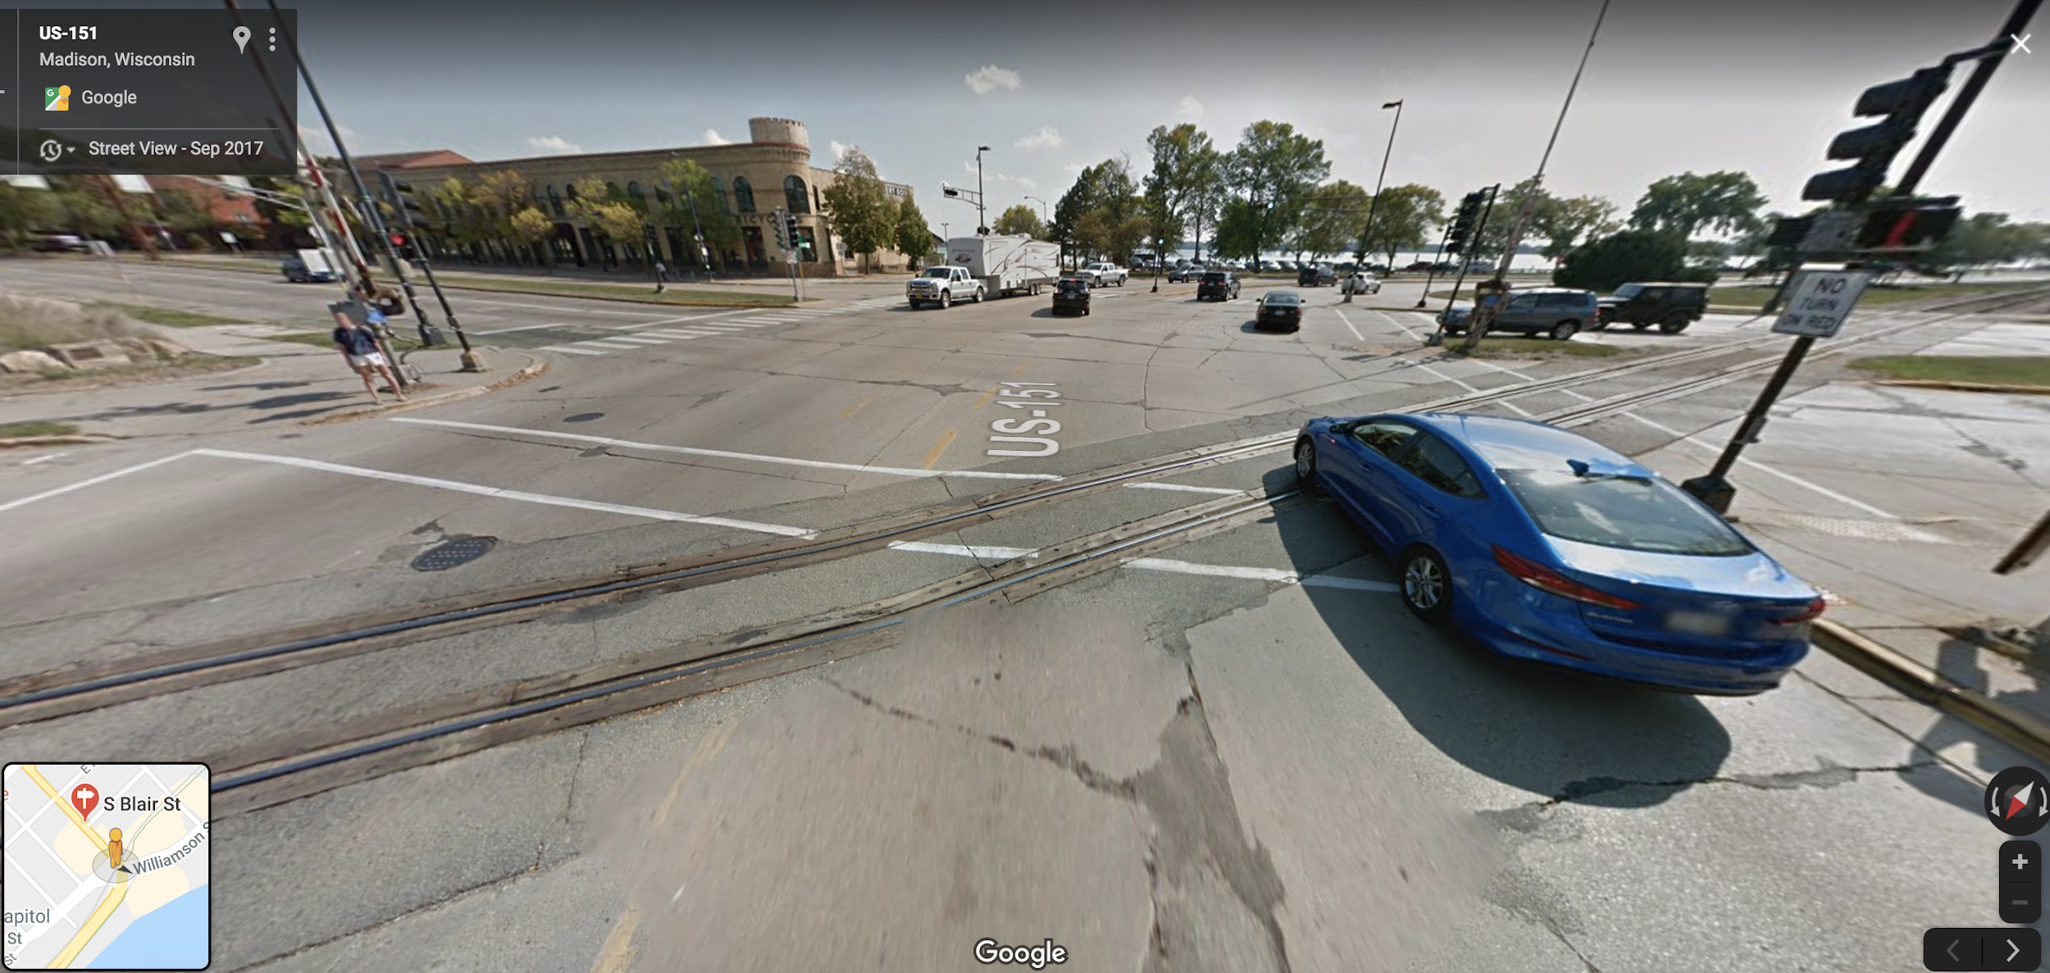
Pedestrians do not have any protectors like helmet, seat belt or eye protection. Therefore, it is very easy for them to die or get injured.
There have trains passing through. But there is no signs for pedestrians to be care of the trains.
Suggestions:
Set train warning signs for pedestrians.
Notes:
So the graph become like this. We can see that injury and property damage of pedestrian are the most. I think it is because...

Slide 7
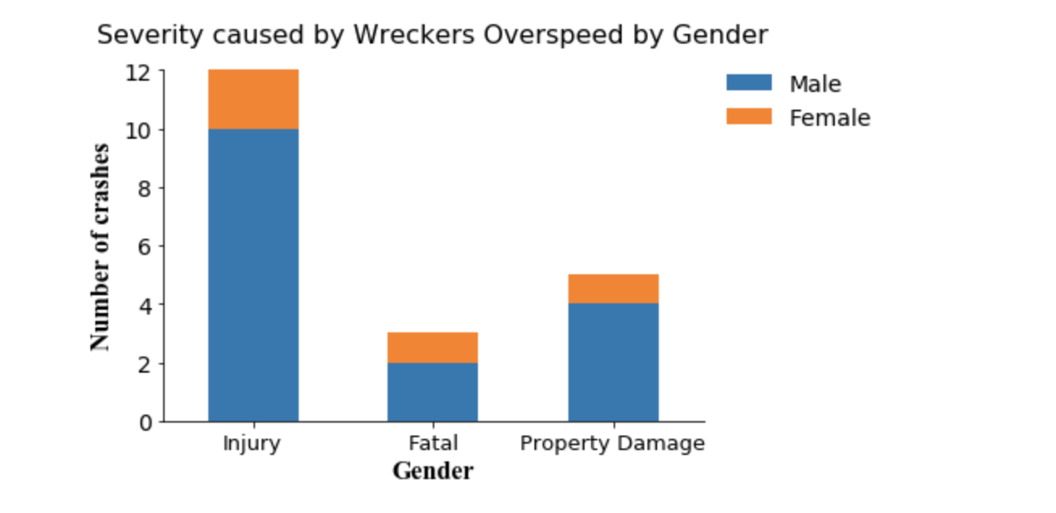
Male wreckers always have much overspeed behavior than female wreckers.
Suggestions:
Install speeding test equipment to control driver’s speed.
Set harsher punishment for overspeed drivers.
Notes:
According to the graph, for injury crashes, fatal crashes, and property damage crashes, males always cause more than female wreckers, which mean that male may exceed limit speed more than females so that it is very hard to reduce speed when they meet emergencies. From the google maps, we can see

Slide 8
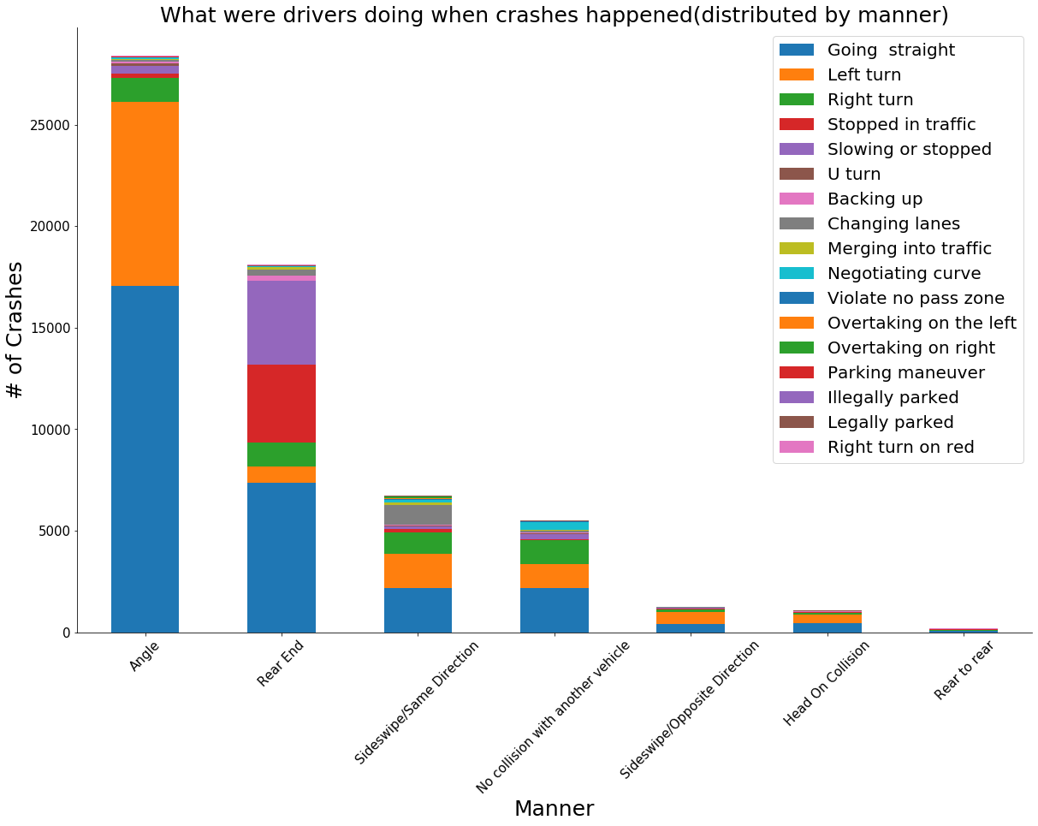
What were drivers doing when crashes happened at interactions in Madison?
Most crashes happened at interactions are angle(side) collisions and rear end collisions.
Rather than going straight, left turn and right turn are more easily to cause angle collisions.
Stopped in traffic and slowing are more easily to cause rear end collisions.
Suggestions:
Update Traffic light system, for example make pedestrian lights light up first than turn signals.
More isolation strip to avoid drivers to go on the wrong side of the road.
Requiring regular brake lamp and fog light check for drivers to avoid rear end collisions
Notes:
Left turns are more dangerous than right turns because: Most drivers tend to accelerate going into a left turn. The wider turning radius of a left turn, combined with higher speed, can result in greater pedestrian exposure and injury. Left-hand turns generally demand more mental and physical effort than right turns.

Slide 9
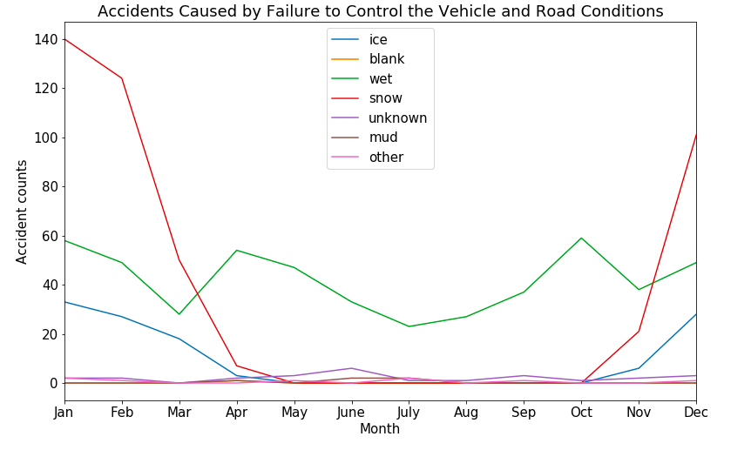
When do crashes happen in a year?
Findings:
1. From October to March, lines for snow and ice go up
2.In April, when the temperature goes up, ice begin to melt and the road become wet
line for wet goes up in April
Suggestion:
Sprinkle salt on the road to accelerate the melting of snow in April

Slide 10
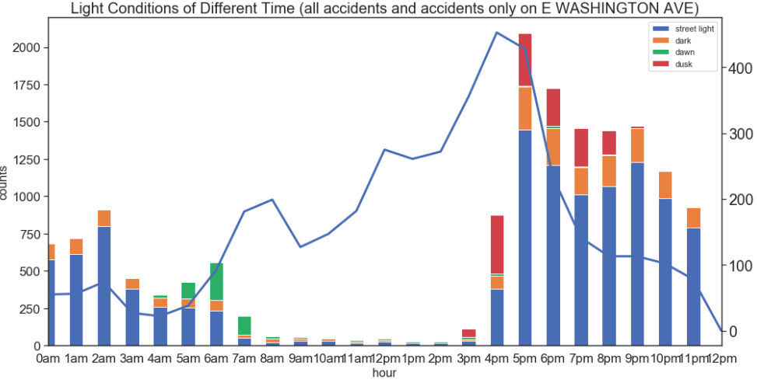
When do crashes happen in a day?
Findings:
1.More accidents at night than at day
2. Peak for E WASHINGTON AVE at 4pm
Peak for all accidents at 5pm
time when we turn on the street light is not appropriate
Suggestions:
Adjust the time when we turn on the street light
(also notice different seasons)

Slide 11
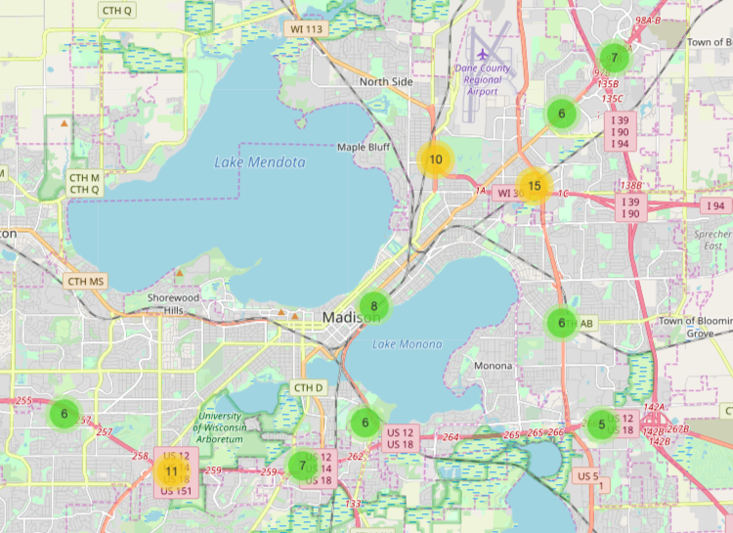
Where do accidents happen?
Map of accidents happening on highways under the reason following too close
Findings:
Accidents are more common at intersections
Common intersections:
US 51 & WI 30
WI 113 &WI30
US 12&US 14
US 12& US 151

Slide 12
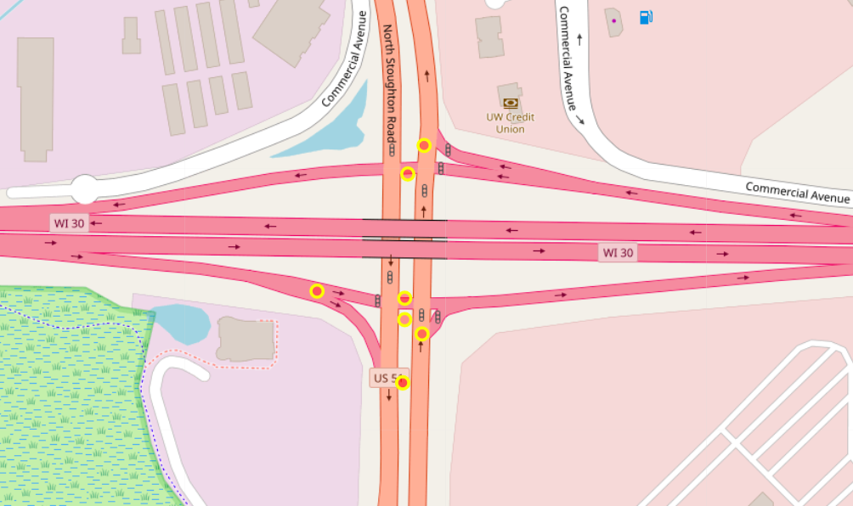
Intersection of US 51 and WI30
Two subreasons:
1. The entrance is too narrow, long lines before entrance
2.The time interval of signal light is not appropriate
Suggestion:
1. Expand the entrances at common intersections
2.adjust the time interval of signal light
Careful!
Which direction?

Slide 13
Questions?

